Slide 1
Lecture Ten Cupolas
Vertical cylindrical furnace equipped with tapping spout near base
Used only for cast irons
Although other furnaces are also used, the largest tonnage of cast iron is melted in cupolas
The "charge," consisting of iron, coke, flux, and any alloying elements, is loaded through a charging door located less than halfway up height of cupola

Slide 2
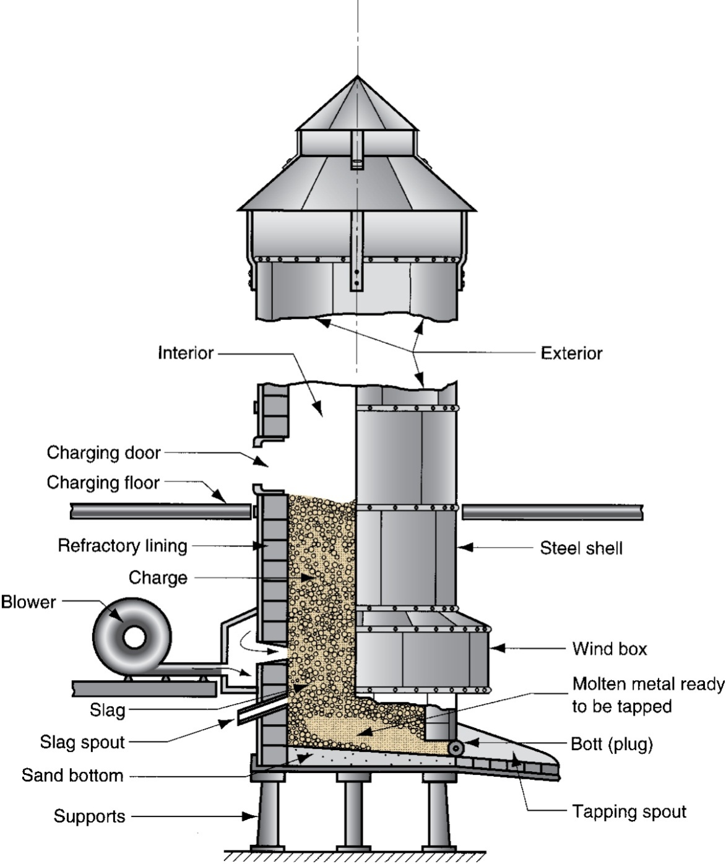
Cupola for melting cast iron

Slide 3
Direct Fuel‑Fired Furnaces
Small open‑hearth in which charge is heated by natural gas fuel burners located on side of furnace
Furnace roof assists heating action by reflecting flame down against charge
At bottom of hearth is a tap hole to release molten metal
Generally used for nonferrous metals such as copper‑base alloys and aluminum

Slide 4
Crucible Furnaces
Metal is melted without direct contact with burning fuel mixture
Sometimes called indirect fuel‑fired furnaces
Container (crucible) is made of refractory material or high‑temperature steel alloy
Used for nonferrous metals such as bronze, brass, and alloys of zinc and aluminum
Three types used in foundries: (a) lift‑out type, (b) stationary, (c) tilting

Slide 5
Three Types of Crucible Furnaces
(a) Lift‑out crucible, (b) stationary pot - molten metal must be ladled, and (c) tilting-pot furnace

Slide 6
Electric‑Arc Furnaces
Charge is melted by heat generated from an electric arc
High power consumption
But electric‑arc furnaces can be designed for high melting capacity
Used primarily for melting steel

Slide 7
Induction Furnaces
Uses alternating current passing through a coil to develop magnetic field in metal
Induced current causes rapid heating and melting
Electromagnetic force field also causes mixing action
Since metal does not contact heating elements, environment can be closely controlled to produce molten metals of high quality and purity
Common alloys: steel, cast iron, and aluminum

Slide 8
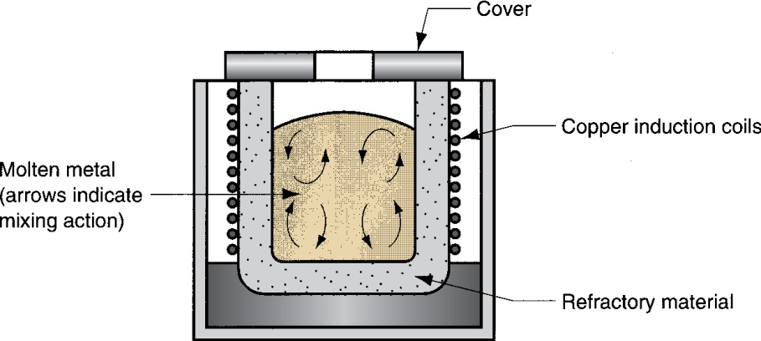
Induction Furnace

Slide 9
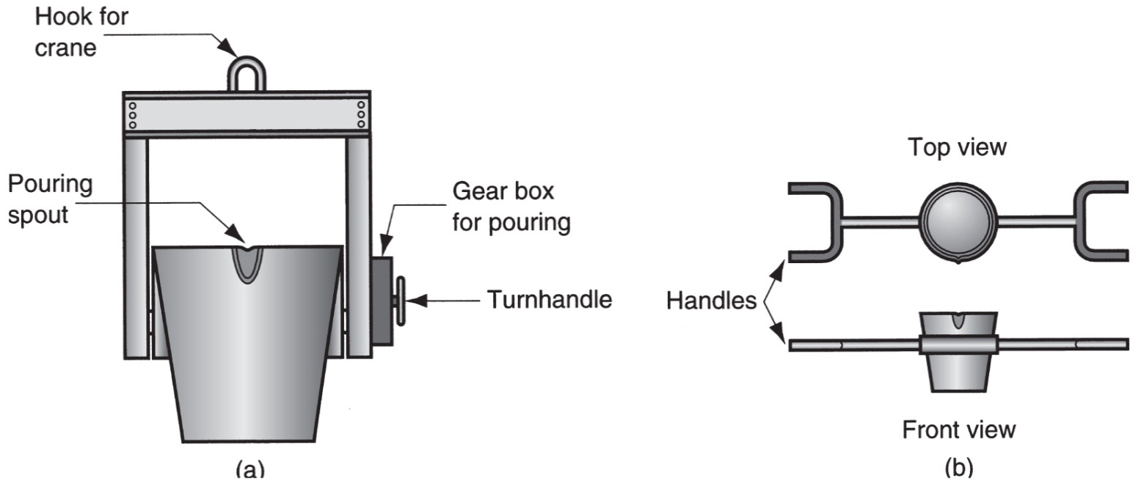
Ladles
Two common types of ladles to transfer molten metals to molds: (a) crane ladle, and (b) two‑man ladle

Slide 10
Additional Steps After Solidification
Trimming
Removing the core
Surface cleaning
Inspection
Repair, if required
Heat treatment

Slide 11
Trimming
Removal of sprues, runners, risers, parting‑line flash, fins, chaplets, and any other excess metal from the cast part
For brittle casting alloys and when cross sections are relatively small, appendages can be broken off
Otherwise, hammering, shearing, hack‑sawing, band‑sawing, abrasive wheel cutting, or various torch cutting methods are used

Slide 12
Removing the Core
If cores have been used, they must be removed
Most cores are bonded, and they often fall out of casting as the binder deteriorates
In some cases, they are removed by shaking the casting, either manually or mechanically
In rare cases, cores are removed by chemically dissolving bonding agent
Solid cores must be hammered or pressed out

Slide 13
Surface Cleaning and Inspection
Removal of sand from casting surface and otherwise enhancing appearance of surface
Cleaning methods: tumbling, air‑blasting with coarse sand grit or metal shot, wire brushing, buffing, and chemical pickling
Surface cleaning is most important for sand casting
Defects are possible in casting, and inspection is needed to detect their presence

Slide 14
Heat Treatment
Castings are often heat treated to enhance properties
Reasons for heat treating a casting:
For subsequent processing operations such as machining
To bring out the desired properties for the application of the part in service

